Slide 1
Foundation of Logic
Foundation of Logic
Dr. M. S. Uddin, CSE Dept, JU

Slide 2
What is logic?
“Logic is the beginning of wisdom, not the end”
The branch of philosophy concerned with analysing the patterns of reasoning by which a conclusion is drawn from a set of premises, without reference to meaning or context is known as logic.
(Collins English Dictionary)
Dr. M. S. Uddin, CSE Dept, JU

Slide 3
Why is logic important?
Logic is a formal method for reasoning.
Logic is a formal language for deducing knowledge from a small number of explicitly stated premises (or hypotheses, axioms, facts).
Logic provides a formal framework for representing knowledge.
Logic differentiates between the structure and content of an argument.
Dr. M. S. Uddin, CSE Dept, JU

Slide 4
What is an argument?
An argument is just a sequence of statements.
Some of these statements, the premises, are assumed to be true and serve as a basis for accepting another statement of the argument, called the conclusion.
Dr. M. S. Uddin, CSE Dept, JU

Slide 5
Deduction and Inference
If the conclusion is justified, based solely on the premises, the process of reasoning is called deduction.
If the validity of the conclusion is based on generalisation from the premises, based on strong but inconclusive evidence, the process is called inference (sometimes called induction).
Dr. M. S. Uddin, CSE Dept, JU

Slide 6
Two examples
Deductive argument:
  “Alexandria is a port or a holiday resort. Alexandria is not a port. Therefore, Alexandria is a holiday resort.”
Inductive argument
  “Most students who did not do the tutorial questions will fail the exam. John did not do the tutorial questions. Therefore John will fail the exam.”
Dr. M. S. Uddin, CSE Dept, JU

Slide 7
Foundation of Logic
Mathematical Logic is a tool for working with compound statements. It includes:
A formal language for expressing them.
A methodology for objectively reasoning about their truth or falsity.
It is the foundation for expressing formal proofs in all branches of mathematics.
We will talk about two logical systems:
Propositional logic
Predicate logic
Dr. M. S. Uddin, CSE Dept, JU

Slide 8
Propositional Logic
Propositional Logic is the logic of compound statements built from simpler statements using so-called Boolean connectives.
Some applications in computer science:
Design of digital electronic circuits.
Expressing conditions in programs.
Queries to databases & search engines.
Dr. M. S. Uddin, CSE Dept, JU
Notes:
We normally attribute propositional logic to George Boole, who first formalized it. Actually the particular formal notation we will present is not precisely Boole’s; he originally spoke of logic in terms of sets, not propositions, and he also used Boolean algebra notation such as AB, A+B, rather than the A /\ B, A \/ B notation we will use. But, he was the first to mathematically formalize these kinds of concepts in preserved writings. Boole’s formalization of logic was developed further by the philosopher Frege.
However, even though logic was not formalized as such until the 1800’s, the basic ideas of it go all the way back to the ancient Greeks. Aristotle (ca. 384-322 B.C.) developed a detailed system of logic (though one that was not quite as convenient and powerful as the modern one), and Chrysippus of Soli (ca. 281-205 B.C.) introduced a logic centered around logic AND, inclusive and exclusive OR, NOT, and implication, similarly to Boole’s. Chrysippus’ logic apparently included all of the key rules that Boole’s logic had. However, his original works were unfortunately lost; we only have fragments quoted by other authors.

Slide 9
Propositional Logic
Definition: A proposition is simply:
a statement (i.e., a declarative sentence)
  with some definite meaning
having a truth value that’s either true (T) or false (F)
  it is never both, neither, or somewhere “in between!”
  however, you might not know the actual truth value.
Dr. M. S. Uddin, CSE Dept, JU
Notes:
We normally attribute propositional logic to George Boole, who first formalized it. Actually the particular formal notation we will present is not precisely Boole’s; he originally spoke of logic in terms of sets, not propositions, and he also used Boolean algebra notation such as AB, A+B, rather than the A /\ B, A \/ B notation we will use. But, he was the first to mathematically formalize these kinds of concepts in preserved writings. Boole’s formalization of logic was developed further by the philosopher Frege.
However, even though logic was not formalized as such until the 1800’s, the basic ideas of it go all the way back to the ancient Greeks. Aristotle (ca. 384-322 B.C.) developed a detailed system of logic (though one that was not quite as convenient and powerful as the modern one), and Chrysippus of Soli (ca. 281-205 B.C.) introduced a logic centered around logic AND, inclusive and exclusive OR, NOT, and implication, similarly to Boole’s. Chrysippus’ logic apparently included all of the key rules that Boole’s logic had. However, his original works were unfortunately lost; we only have fragments quoted by other authors.

Slide 10
Propositions in Propositional Logic
Simple types of statements, called propositions, are treated as atomic building blocks for more complex statements.
Atoms: p, q, r, …
(Corresponds with simple English sentences, e.g.
`I had salad for lunch’)
Complex propositions : built up from atoms using operators: p ∧q
(Corresponds with compound English sentences, e.g., “I had salad for lunch and I had steak for dinner.”)
Dr. M. S. Uddin, CSE Dept, JU

Slide 11
Some Popular Boolean Operators
Formal Name | Nickname | Arity | Symbol
Negation operator | NOT | Unary | ¬
Conjunction operator | AND | Binary | ∧
Disjunction operator | OR | Binary | ∨
Exclusive-OR operator | XOR | Binary | ⊕
Implication operator | IMPLIES | Binary | →
Biconditional operator | IFF | Binary | ↔
Dr. M. S. Uddin, CSE Dept, JU

Slide 12
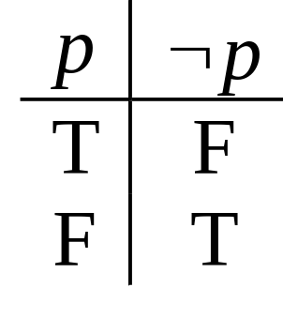
The Negation Operator
The unary negation operator “¬” (NOT) transforms a prop. into its negation.
E.g. If p = “I have brown hair.”
then ¬p = “I do not have brown hair.”
The truth table for NOT:
T :≡ True; F :≡ False
Dr. M. S. Uddin, CSE Dept, JU

Slide 13
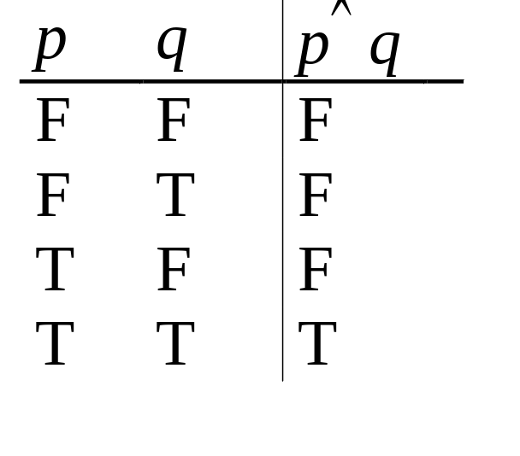
The Conjunction Operator
The binary conjunction operator “∧” (AND) combines two propositions to form their logical conjunction.
E.g. If p=“I will have salad for lunch.” and q=“I will have steak for dinner.”, then p∧q=“I will have salad for lunch and I will have steak for dinner.”
Note that a
conjunction
p₁ ∧ p₂ ∧ … ∧ p_{n}
of n propositions
will have 2^{n} rows
in its truth table.
Dr. M. S. Uddin, CSE Dept, JU

Slide 14
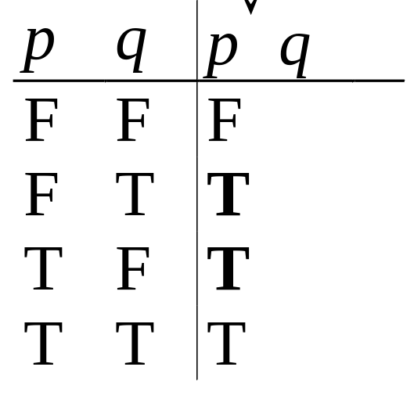
The Disjunction Operator
The binary disjunction operator “∨” (OR) combines two propositions to form their logical disjunction.
p=“My car has a bad engine.”
q=“My car has a bad carburator.”
p∨q=“Either my car has a bad engine, or
my car has a bad carburetor.”
Note that p∨q means
that p is true, or q is
true, or both are true!
So, this operation is
also called inclusive or,
because it includes the
possibility that both p and q are true.
Dr. M. S. Uddin, CSE Dept, JU
Notes:
OR is also commutative and associative.
The animated picture on the right is just a memory device to help you remember that the disjunction operator is symbolized with a downward-pointing wedge, like the blade of an axe, because it “splits” a proposition into two parts, such that you can take either part (or both), if you are trying to decide how to make the whole proposition true.
Note that the meaning of disjunction is like the phrase “and/or” which is sometimes used in informal English. “The car has a bad engine and/or a bad carburetor.”

Slide 15
Nested Propositional Expressions
Use parentheses to group sub-expressions:
“I just saw my old friend, and either he’s grown or I’ve shrunk.” = f ∧ (g ∨ s)
  (f ∧ g) ∨ s would mean something different
  f ∧ g ∨ s would be ambiguous
By convention, “¬” takes precedence over both “∧” and “∨”.
Dr. M. S. Uddin, CSE Dept, JU
Notes:
As an exercise, drop the truth tables for f /\ (g \/ s) and (f /\ g) \/ s to see that they’re different, and thus the parentheses are necessary.
Precedence conventions such as the one in the second bullet help to reduce the number of parentheses needed in expressions. Note that negation, with its tight binding (high precedence), and with its position to the left of its operand, behaves similarly to a negative sign in arithmetic.
There is also a precedence convention that you see sometimes (for example, in the C programming language) that AND takes precedence over OR. However, this convention is not quite universally accepted, not all systems adopt it. Therefore, to be safe, you should always include parentheses whenever you are mixing ANDs and ORs in a single sequence of binary operators.

Slide 16
Tautologies/Contradictions/Contigencies
A tautology is a compound proposition that is true no matter what the truth values of its atomic propositions are!
Ex. p ∨ ¬p =1
A contradiction is a compound proposition that is false no matter what the truth values of its atomic propositions are!
Ex. p ∧ ¬p =0
All other propositions are contingencies:
Some rows give T, others give F.
Dr. M. S. Uddin, CSE Dept, JU

Slide 17
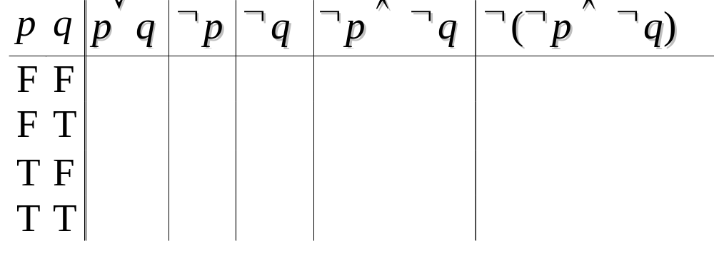
Logical Equivalence
Compound proposition p is logically equivalent to compound proposition q, written p⇔q, IFF p and q contain the same truth values in all rows of their truth tables
We will also say: they express the same truth function (= the same function from values for atoms to values for the whole formula).
Ex. Prove that p∨q ⇔ ¬(¬p ∧ ¬q).
F
T
T
T
F
T
T
F
F
T
T
F
T
F
T
T
F
F
F
T
Dr. M. S. Uddin, CSE Dept, JU

Slide 18
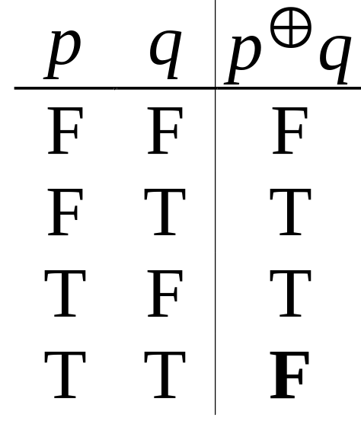
The Exclusive Or Operator
The binary exclusive-or operator “⊕” (XOR) combines two propositions to form their logical “exclusive or”.
p = “I will earn an A in this course,”
q = “I will drop this course,”
p ⊕ q = “I will either earn an A in this course, or I will drop it (but not both!)”
Note that p⊕q means
that p is true, or q is
true, but not both!
This operation is
called exclusive or,
because it excludes the
possibility that both p and q are true.
Dr. M. S. Uddin, CSE Dept, JU

Slide 19
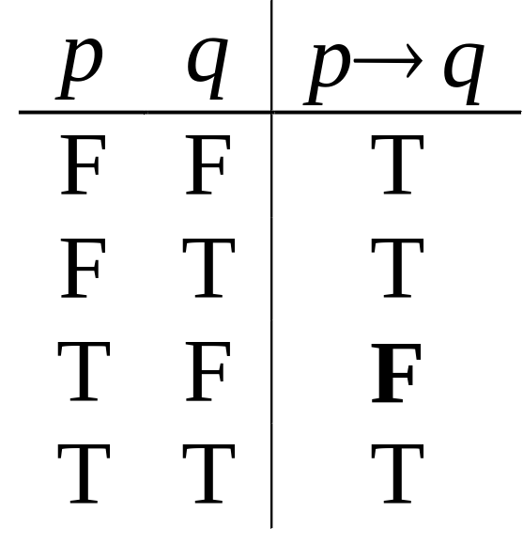
The Implication Operator
The implication p → q states that p implies q.
i.e., if p is true, then q is true; but if p is not true, then q could be either true or false.
e.g., let p = “You study hard.”
q = “You will get a good grade.”
p → q = “If you study hard, then you will get a good grade.”
p → q is false only when
(p is true but q is not true)
p → q does not say
that p causes q!
p → q does not require
that p or q are true!
Dr. M. S. Uddin, CSE Dept, JU
Notes:
Note that the definition of “p implies q” says: “If p is true, then q is true, and if p is not true, then q is either true or false.” Well, saying that q is either true or false is not saying anything, since any proposition is, by the very definition of a proposition, either true or false. So, the last part of that sentence (covering the case where p is not true) is not really saying anything. So we may as well say the definition is, “If p is true, then q is true.”
Sometimes the antecedent is called the hypothesis and the consequent is called the conclusion.

Slide 20
Implications between real sentences
“If this lecture ever ends, then the sun has risen this morning.” True or False?
“If Tuesday is a day of the week, then I am a penguin.” True or False?
“If 1+1=6, then Bush is president.”
True or False?
“If the moon is made of green cheese, then I am richer than Bill Gates.” True or False?
Dr. M. S. Uddin, CSE Dept, JU
Notes:
The first one is true because T->T is True. It doesn’t matter that my lecture ending is not the cause of the sun rising tomorrow.
The second one is false for me, because although Tuesday is a day of the week, I am most certainly NOT a penguin. (But, if a penguin were to say this statement, then it would be true for him.)
The third one is true, because 1+1 is not equal to 6. F->T is True.
The last one is true, because the moon is not made of green cheese. F->F is True.
In other words, anything that’s false implies anything at all. p->q if p is false. Why? If p is false, then if p is true, then p is both false and true at the same time, and so truth and falsity are the same thing. So if q is false then q is true.

Slide 21
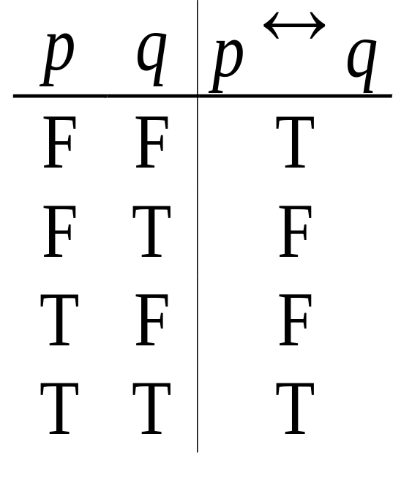
Biconditional Truth Table
p ↔ q means that p and q
have the same truth value.
Note this truth table is the
exact opposite of ⊕’s!
  Thus, p ↔ q means ¬(p ⊕ q)
p ↔ q does not imply
that p and q are true,
or that either of them causes the other.
Dr. M. S. Uddin, CSE Dept, JU
Notes:
Also, p IFF q is equivalent to (p -> q) /\ (q -> p). (“/\” being the AND wedge)

Slide 22
Converse/Contrapositive
Some terminology, for an implication p → q:
Its converse is: q → p.
Its contrapositive: ¬q → ¬ p.
Dr. M. S. Uddin, CSE Dept, JU
Notes:
Also, note that the converse and inverse of p->q also have the same meaning as each other.

Slide 23
Logical Equivalences
Identity: p∧T ⇔ p p∨F ⇔ p
Domination: p∨T ⇔ T p∧F ⇔ F
Idempotence: p∨p ⇔ p p∧p ⇔ p
Double negation: ¬¬p ⇔ p
Commutativity: p∨q ⇔ q∨p p∧q ⇔ q∧p
Associativity: (p∨q)∨r ⇔ p∨(q∨r)
(p∧q)∧r ⇔ p∧(q∧r)
Dr. M. S. Uddin, CSE Dept, JU

Slide 24
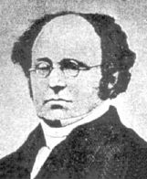
More Equivalence Laws
Distributive: p∨(q∧r) ⇔ (p∨q)∧(p∨r)
p∧(q∨r) ⇔ (p∧q)∨(p∧r)
De Morgan’s Laws:
¬(p∧q) ⇔ ¬p ∨ ¬q
¬(p∨q) ⇔ ¬p ∧ ¬q
Trivial tautology/contradiction:
p ∨ ¬p ⇔ T p ∧ ¬p ⇔ F
Augustus
De Morgan
(1806-1871)
Dr. M. S. Uddin, CSE Dept, JU

Slide 25
Predicate Logic
Predicate logic is an extension of propositional logic that permits quantification over classes of entities.
Propositional logic (recall) treats simple propositions (sentences) as atomic entities.
A ‘predicate’ is just a property
Predicates define relationships between any number of entities using qualifiers:
  ∀ “for all”, “for every”
  ∃ “there exists”
  Remember:
  ∀ x ‘for every x’, or ‘for All x’
  ∃ x ‘there is an x’ or ‘there Exists an x’
Dr. M. S. Uddin, CSE Dept, JU

Slide 26
Applications of Predicate Logic
It is one of the most-used formal notations for writing mathematical definitions, axioms, and theorems.
For example, in linear algebra, a partial order is introduced saying that a relation R is reflexive and transitive – and these notions are defined using predicate logic.
Basis for many Artificial Intelligence systems.
Predicate-logic like statements are supported by some of the more sophisticated database query engines.
Dr. M. S. Uddin, CSE Dept, JU
Notes:
E.g., Axyz((Rxy & Ryz) → Rxz))

Slide 27
Propositional/Predicate logic
In propositional logic, we could not simply say whether a formula is TRUE; what we could say is whether it is TRUE with respect to a given assignment of TRUE/FALSE to the Atoms in the formula
e.g., p → q is TRUE with respect to the assignment p =TRUE, q = TRUE
In predicate logic, we say that a formula is TRUE (FALSE) with respect to a model.
Dr. M. S. Uddin, CSE Dept, JU

